Slide 1

Development of a web application for browsing BBMRI -omics data
Jan Bert van Klinken

Slide 2
Introduction
In BBMRI-NL a unique collection of omics datasets have been generated, reflecting different layers of biological processes
metabolome (NMR)
transcriptome (RNA-seq)
epigenome (CpG methylation)
genome (SNP genotyping)

Slide 3
Introduction
Within BBMRI-NL, the BIOS consortium aims at integrating these layers of data, in order to uncover molecular pathways involved in health and disease.
Genome-wide association analyses between omics layers:
genome -> methylome (meQTLs)
genome -> transcriptome (eQTLs: gene, exon,
exon ratio, polyA ratio)
genome -> metabolome (metabolite QTLs)
methylome -> transcriptome (eQTMs)
methylome -> metabolome
transcriptome -> metabolome

Slide 4
BBMRI -omics atlas
An important task of BBMRI-NL 2.0 is to make the association results available to the public. To this end, a web browser has been developed by the BIOS team: http://genenetwork.nl/biosqtlbrowser
Data can be downloaded all at once
or the database can be queried
for specific SNPs, CpG sites, genes.
Currently, query results are presented
in tabular format separately for each
association study.

Slide 5
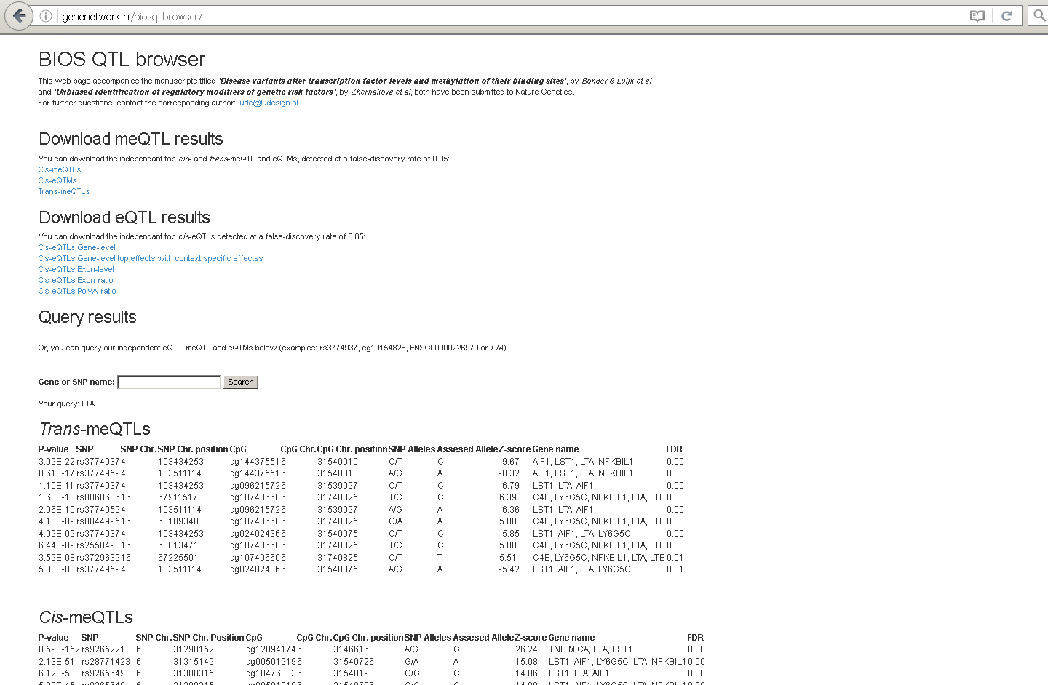
BBMRI -omics atlas (current online version)

Slide 6
BBMRI -omics atlas (current online version)
bulk download
query database
query results

Slide 7
BBMRI -omics atlas
Several aspects of the current browser have to be improved.
Goal
Make the BBMRI atlas accessible for and interpretable by a wide range
of users* through a user-friendly** and sustainable*** web application.
* users with different expertises and backgrounds
** present results in a visually more appealing way
*** easy to maintain and to add new association results or data layers

Slide 8
BBMRI -omics atlas
Features
Make interface more user-friendly
--> give browser more modern design
--> interactive association tables
--> visualise association results as a layered network
Enable complex/composite queries
--> submit a list of genetic variants, CpGs or genes
--> submit e.g. variant-gene or variant-disease combinations
Download query results
Develop API to facilitate data access
--> what type of interface with server?

Slide 9
BBMRI -omics atlas
Features
Calculate Linkage Disequilibrium between query SNP and
top me/eQTLs from conditional analyses
--> QTL tables only contain SNPs with strongest associations
--> report also unconditional association of query SNP?
Functional annotation of genetic variants and methylation sites
--> import data from ENCODE on histone marks, DNAse activity, TF binding
--> how to maintain?
Gather gene-specific knowledge from external databases
--> e.g. UniProt, ExPASy, TCDB, OMIM, Gene Ontology, etc.
--> how to maintain?
--> copyrighted database content; restricted content (KEGG, OMIM)

Slide 10
BBMRI -omics atlas
Features
FAIR-ification of BBMRI data (Findable Accessible Interoperable Reusable)
--> store data in specific, machine readable format (RDF)
--> assign metadata (data identifiers, provenance, usage/license)
--> index or submit data to searchable resource
include results of other BBMRI -omics (association) studies
--> add metabolomics/phenotype layer
--> splice site data, allele specific expression
--> QTLs based on Haplotype Reference Consortium imputation

Slide 11
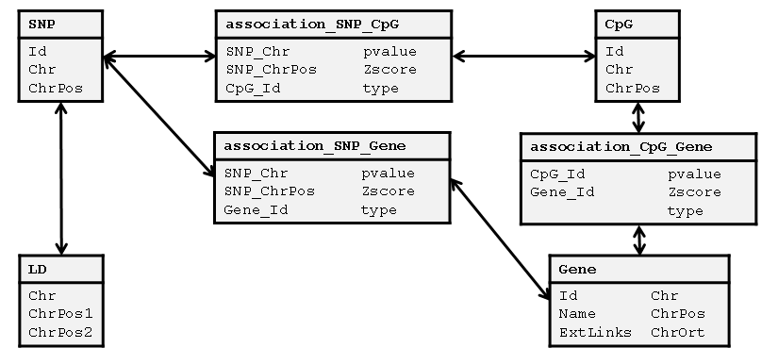
Implementation
Overall workflow
data standardisation
import in PostgreSQL
BBMRI -omics association study results
SNP.txt
LD.txt
CpG.txt
Gene.txt
association_SNP_CpG.txt
association_SNP_Gene.txt
association_CpG_Gene.txt
external SNP/ CpG/gene knowledge bases
communication
web-postgres server
server.js
Node+Express
communication client-server via HTTP POST
index.html
main.js

Slide 12
Implementation
Data standardisation
import results from BBMRI association studies (standardise header)
import SNP/CpG/gene specific knowledge from external databases
import TSV files into PostgreSQL (CREATE TABLE and COPY)
create index for fields that are queried
SNP
Id Chr ChrPos
association_SNP_CpG
SNP_Chr pvalue SNP_ChrPos Zscore CpG_Id type
CpG
Id Chr ChrPos
association_SNP_Gene
SNP_Chr pvalue SNP_ChrPos Zscore Gene_Id type
association_CpG_Gene
CpG_Id pvalue Gene_Id Zscore type
LD
Chr ChrPos1 ChrPos2
Gene
Id Chr Name ChrPos ExtLinks ChrOrt

Slide 13
Implementation
Interaction server-PostgreSQL
communication via node-postgres module
JSON query from browser/API is translated by the server into a series
of consecutive SQL SELECT commands
enable graph-like searches
Example:
SELECT Chr,ChrPos FROM SNP WHERE IdStr IN ('rs11781667');
SELECT * FROM LD INNER JOIN association_SNP_CpG ON (LD.Chr=association_SNP_CpG.
SNP_Chr AND LD.ChrPos2=association_SNP_CpG.SNP_ChrPos) WHERE (LD.Chr,LD.ChrPos1)
IN (('8 ',145040856));
SELECT * FROM LD INNER JOIN association_SNP_Gene ON (LD.Chr=association_SNP_Gene.
SNP_Chr AND LD.ChrPos2=association_SNP_Gene.SNP_ChrPos) WHERE (LD.Chr,LD.ChrPos1)
IN (('8 ',145040856));
SELECT * FROM association_CpG_Gene WHERE CpG_IdStr IN ('cg01640991','cg01640991',...
SELECT * FROM SNP WHERE (Chr,ChrPos) IN (('8 ',145040856),('8 ',145037573),...
SELECT * FROM CpG WHERE (IdStr) IN ('cg01640991','cg01640991',...
SELECT * FROM Gene WHERE (IdNum) IN (178209,185189,255343,185189,...

Slide 14
Implementation
Client-side
implemented in JavaScript, Bootstrap for layout
single page web application with Angular
--> fast response with menu/tab switching, table sorting, popup
window appearance, downloading results
Client-server communication
both the browser and the API communicate to the server via a HTTP POST, in which a JSON containing the query is sent, and the resulting association and SNP/CpG/gene tables are returned as a JSON

Slide 15
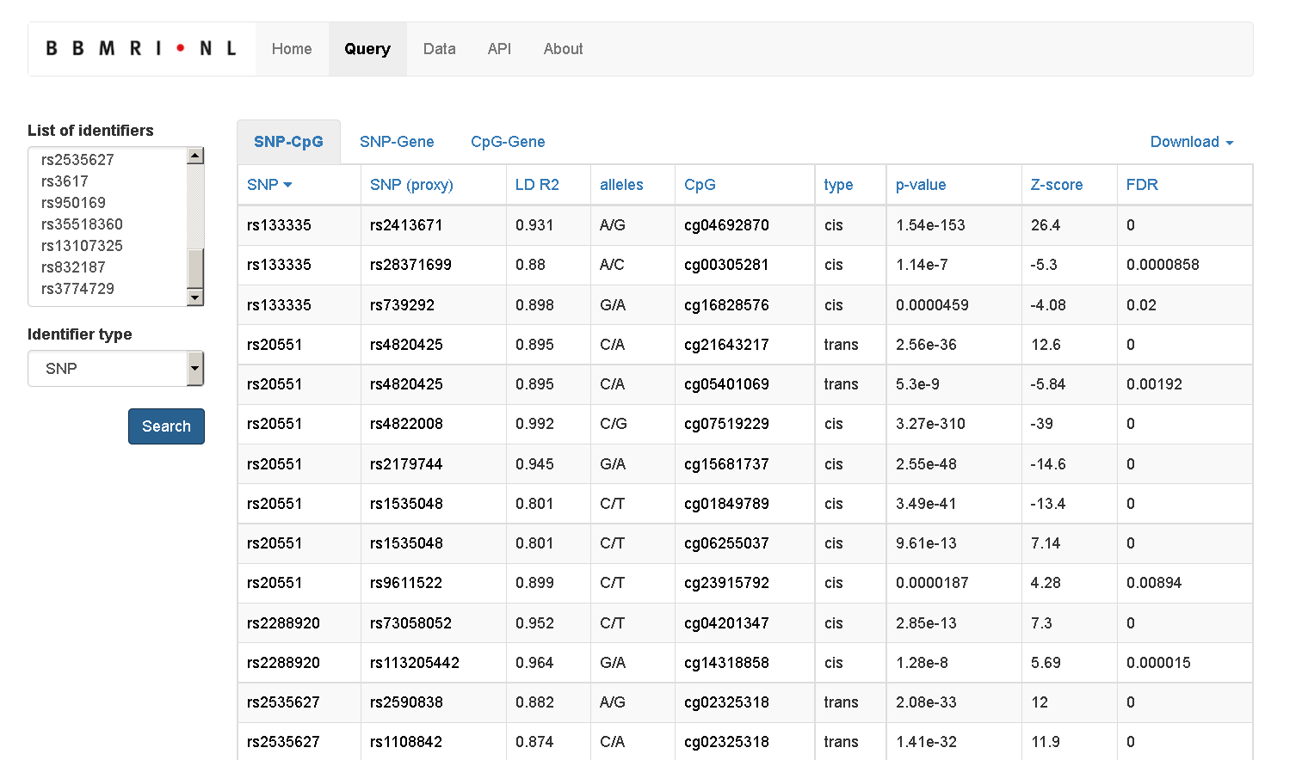
Results

Slide 16
Results
Data access via API: send/ receive JSON via HTTP POST
Graph search: eQTMs affected by meQTLs are also returned
LD calculation: me/eQTLs in LD with query SNPs are returned
Download query results (JSON/TSV)
Query list of SNPs/CpGs/
genes
Interactive table: SNPs/CpGs/genes can be clicked for more info

Slide 17
Current/future work
Done:
give browser modern design
make it possible to query a list of SNPs/CpGs/genes
calculate Linkage Disequilibrium (LD) between query SNP and
top me/eQTLs from conditional analyses
make it possible to download query results
implement API to facilitate data access
To do:
put browser online
enrich atlas with SNP/CpG/gene specific knowledge from external databases (ENCODE, pathway DBs, OMIM, etc)
FAIR-ification of QTL results (Findable Accessible Interoperable Reusable)
include results of other BBMRI -omics (association) studies

Slide 18
Current/future work
Make browser more user-friendly and flexible:
better represent omics data layers and associations between layers
variants
CpG sites
genes
phenotypes

Slide 19
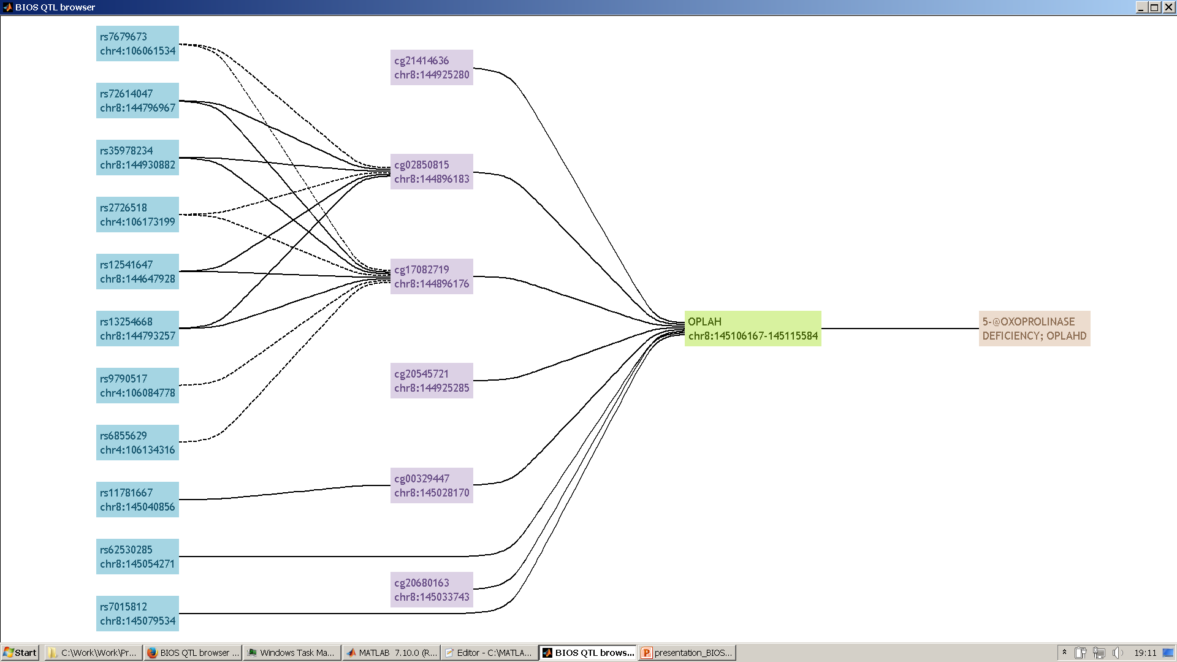
Current/future work
Alpha version of graph based interface of browser (query: OPLAH)

Slide 20
Conclusion
Integration of GWAS loci with methylation/expression QTL data and knowledge bases is important for their interpretation.
Task of BBMRI-NL 2.0 to develop a user-friendly and sustainable
web application to browse results from -omics association studies.
Current online version: http://genenetwork.nl/biosqtlbrowser .
New browser has been developed, will soon be put online.
Which additional features will/should be added is open for discussion.

Slide 21

Acknowledgements
Peter-Bram 't Hoen
Bas Heijmans
Rick Jansen
Leon Mei
Maarten van Iterson
Morris Swertz
Lude Franke
Joyce van Meurs

