Slide 1
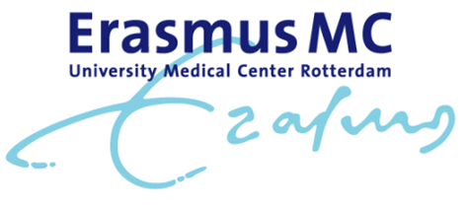
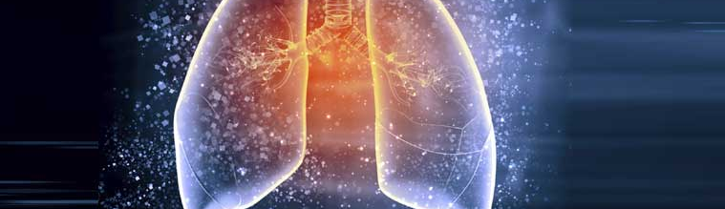

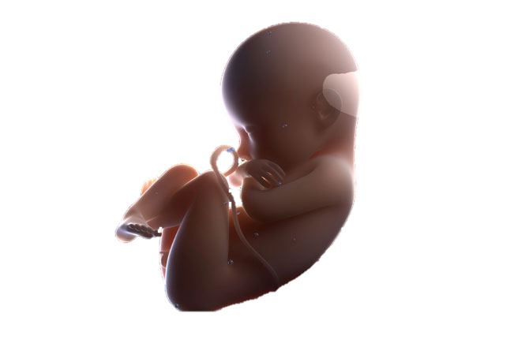



Newborn DNA-methylation, childhood lung function, and the risks of asthma and COPD across the life course
Martijn den Dekker
September 21th, 2016

Slide 2
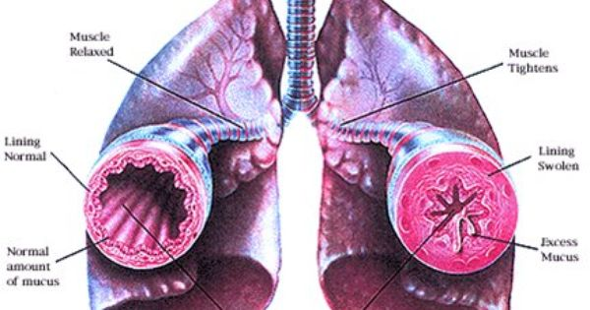
Background
Asthma and COPD are major global health problems
Characterised by airway obstruction
Lung function trajectories are predictive for later life asthma or COPD

Slide 3
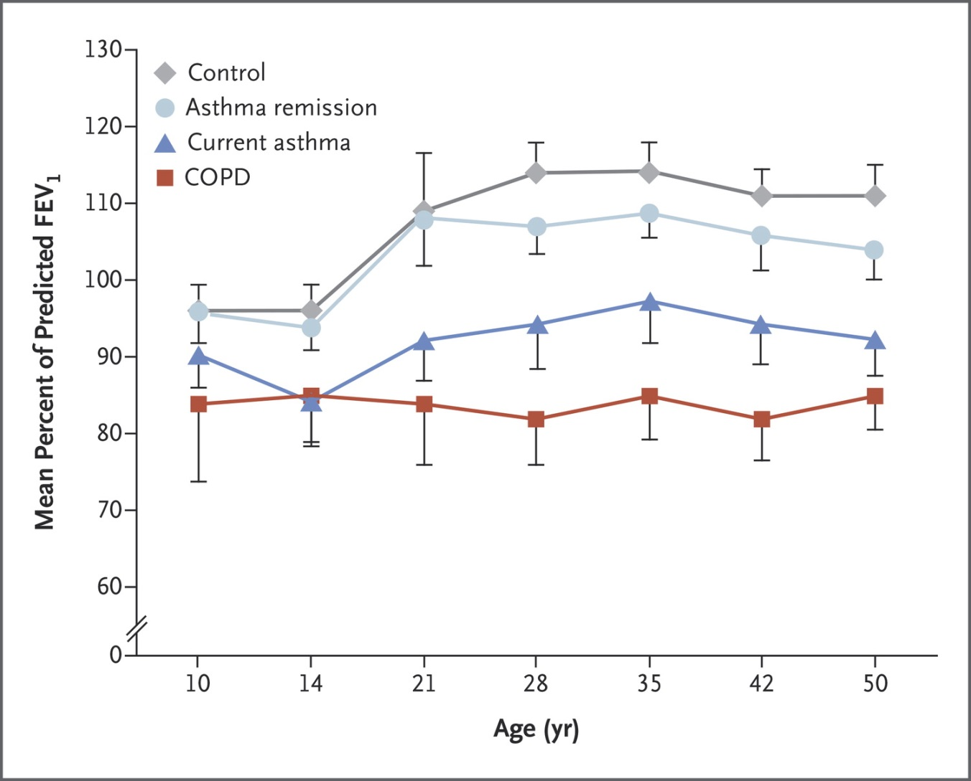
Background
Martinez FD. N Engl J Med 2016;375:871-878.
Notes:
Percent of Predicted FEV₁ in Participants Followed between the Ages of 10 and 50 in the Melbourne Asthma Study.Participants were classified at 50 years of age as follows: no asthma (control), current asthma, childhood asthma with remission in adult life, and stage 1 COPD, defined as an FEV1 of 80% or more of the predicted value and an FEV1:FVC ratio of less than 0.70. Among participants with COPD, airway obstruction that justified a definition of COPD was already present at 10 years of age. Adapted with permission from Tai et al.42

Slide 4
Background
Martinez FD. N Engl J Med 2016;375:871-878.
Notes:
Percent of Predicted FEV₁ in Participants Followed between the Ages of 10 and 50 in the Melbourne Asthma Study.Participants were classified at 50 years of age as follows: no asthma (control), current asthma, childhood asthma with remission in adult life, and stage 1 COPD, defined as an FEV1 of 80% or more of the predicted value and an FEV1:FVC ratio of less than 0.70. Among participants with COPD, airway obstruction that justified a definition of COPD was already present at 10 years of age. Adapted with permission from Tai et al.42

Slide 5
Hypothesis
Pre-conceptional
Embryonal-Fetal
Neonatal
Childhood
Adulthood
Exposure
Adverse exposures
Obesity, inadequate diet, tobacco smoke, allergens, respiratory infections
DNA methylation & RNA transcription
Mechanism
Genetic susceptibility
Loci at or near genes on chromosomes 1, 2, 4-6, 8-12, 14, 15, 17, 21, 22
Impaired Adaptations Impaired
Growth lung development lung structure & function
Disease
BPD Wheezing Asthma COPD
Duijts et al., Eur J Epidemiol, 2014.

Slide 6

Aim
To assess the associations between
DNA-methylation in cord blood and
lung function, asthma and COPD across the life course

Slide 7
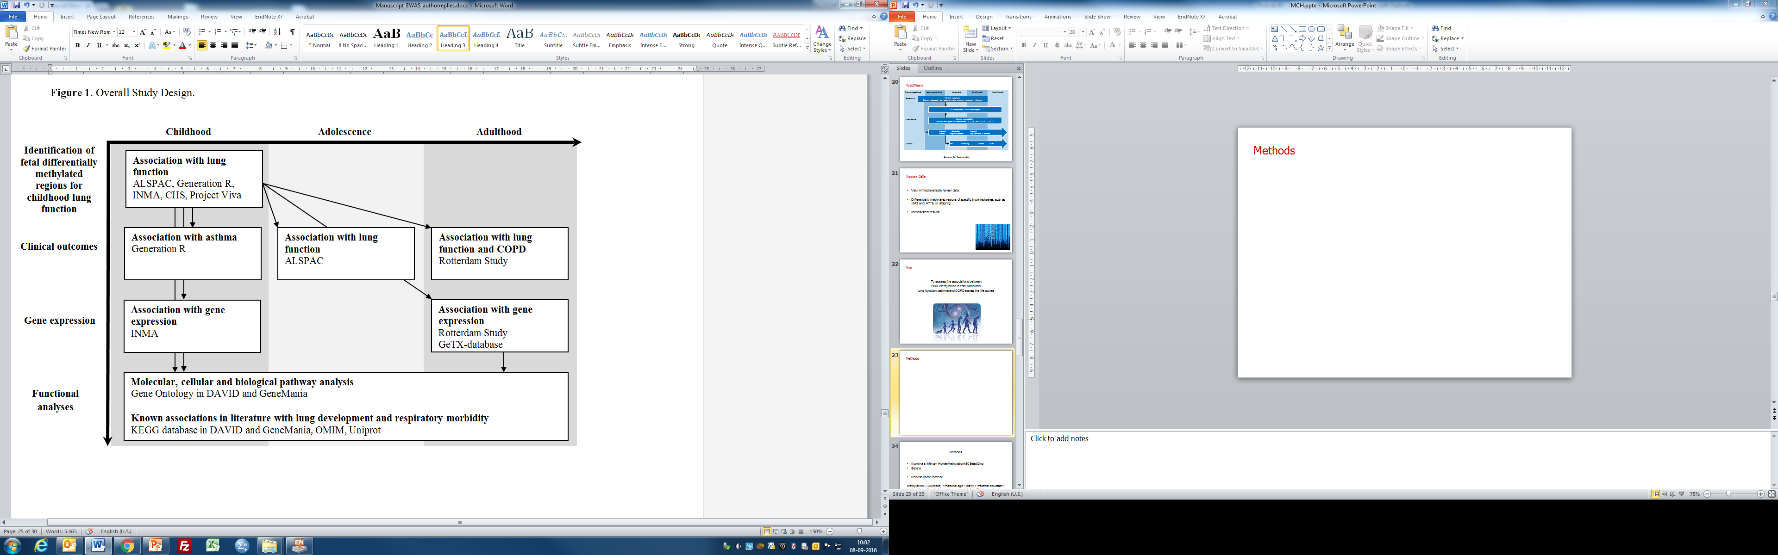
Methods - design

Slide 8
Methods
Discovery analysis

Slide 9
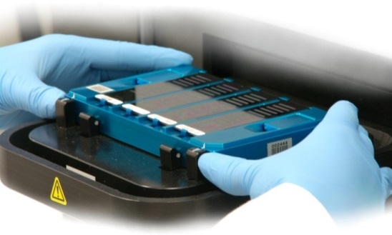
Methods – discovery analysis
Five population-based birth cohort studies (n = 1,688)
  ALSPAC, GenR, INMA, CHS, Project Viva
Illumina Infinium HumanMethylation450 BeadChip
Robust linear models
  Adjusted for confounders, batch effect and cell count estimations
457,748 CpGs in meta-analysis
Identification of DMRs
  COMB-P

Slide 10
Methods – discovery analysis
A differentially methylated region (DMR) is a genomic region with multiple adjacent CpG sites that exhibit different methylation statuses among multiple samples
Identification of DMRs as opposed to single CpGs is conceptually consistent with what is known about DNA methylation patterns in the human genome
  a single methylated CpG may occasionally be linked to gene expression regulation
  DMRs can control cell-type-specific transcriptional repression of an associated gene
Bock C. Nature Reviews Genetics 13(2012)

Slide 11
Methods
Secondary analyses
Notes:
INCLUDES THE BIOS DATA

Slide 12
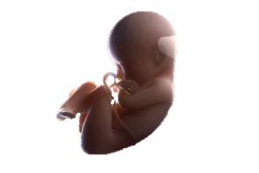



Methods – secondary analyses
Associations of identified DMRs with:
  Asthma in children (Generation R)
  Lung function in adolescents and adults (ALSPAC, Rotterdam Study)
  COPD in adults (Rotterdam Study)
  Gene expression in children (INMA)
  Gene expression in adults (Rotterdam Study)
Pathway analyses

Slide 13
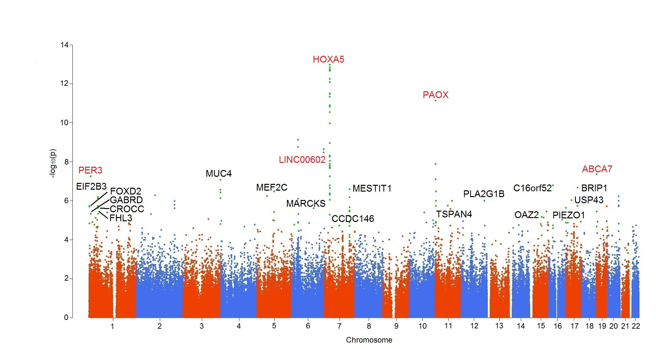
Results – discovery analysis
FEV₁

Slide 14
Results – top 10 DMRs associated with childhood lung function
 | Chromo-some | No. of probes | P-value | Nearest gene | Distance to TSS (bases)
FEV₁ | 1 | 5 | 7.27E-05 | PER3 | 42,618
 | 6 | 4 | 4.55E-06 | LINC00602 | 17,931
 | 7 | 47 | 3.05E-14 | HOXA5 | -706
 | 10 | 7 | 6.65E-09 | PAOX | 10,121
 | 19 | 3 | 3.83E-05 | ABCA7 | 23,820
FEV₁/FVC | 1 | 4 | 3.59E-06 | CLCA1 | 33,790
 | 5 | 6 | 6.95E-05 | NUDT12 | 12
 | 10 | 11 | 4.28E-05 | VENTX | -42
FEF₇₅ | 7 | 6 | 1.14E-06 | PTPRN2 | -2,155
 | 14 | 10 | 2.20E-06 | TCL1A | -192

Slide 15
Results – top 10 DMRs associated with childhood lung function
 | Chromo-some | No. of probes | P-value | Nearest gene | Distance to TSS (bases)
FEV₁ | 1 | 5 | 7.27E-05 | PER3 | 42,618
 | 6 | 4 | 4.55E-06 | LINC00602 | 17,931
 | 7 | 47 | 3.05E-14 | HOXA5 | -706
 | 10 | 7 | 6.65E-09 | PAOX | 10,121
 | 19 | 3 | 3.83E-05 | ABCA7 | 23,820
FEV₁/FVC | 1 | 4 | 3.59E-06 | CLCA1 | 33,790
 | 5 | 6 | 6.95E-05 | NUDT12 | 12
 | 10 | 11 | 4.28E-05 | VENTX | -42
FEF₇₅ | 7 | 6 | 1.14E-06 | PTPRN2 | -2,155
 | 14 | 10 | 2.20E-06 | TCL1A | -192

Slide 16
Results
59 DMRs identified

Slide 17
Results

Slide 18
Results – clinical outcomes
Adult lung function
5 DMRs
2 DMRs
2 DMRs
Childhood asthma
Adult COPD
2 DMRs
15 DMRs
5 DMRs

Slide 19
Results – clinical outcomes
Adult lung function
HOXA5
5 DMRs
2 DMRs
2 DMRs
Childhood asthma
Adult COPD
2 DMRs
15 DMRs
5 DMRs

Slide 20
Results

Slide 21
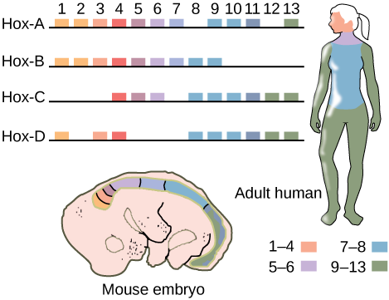
Results – Gene expression of HOX-genes

Slide 22
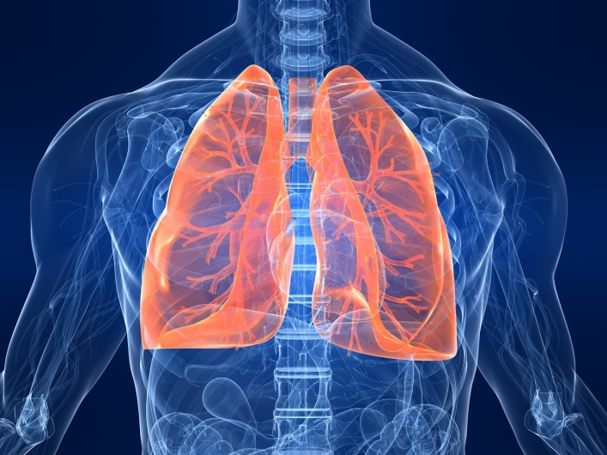
Results – Gene expression and functional pathways
Annotated gene | Expressed gene | Gene expression in children | Gene expression in adults | Previously associated with lung development or respiratory morbidity
HOXA5 | HOXA1, HOTTIP | ↓ | ↓ | Lung development, FEV₁, FEV₁/FVC
 | EVX1, HOXA4, HOXA7 | ↓ |  | Lung development, asthma, COPD

Slide 23
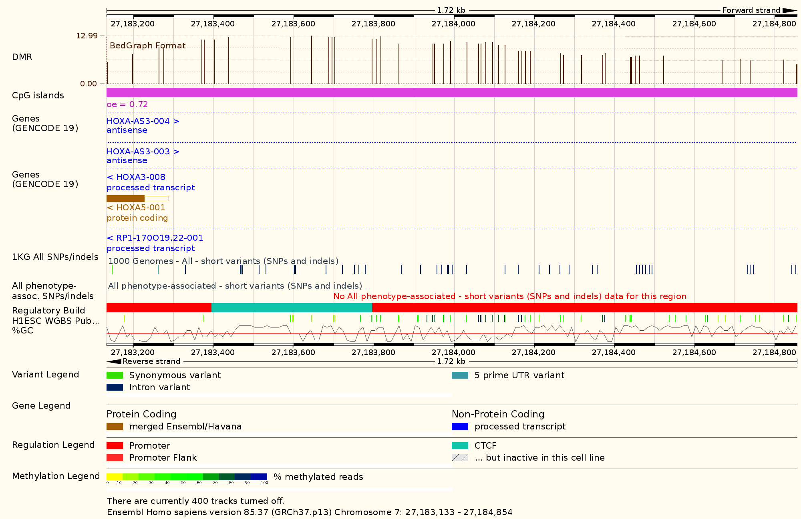
Results – Gene expression and functional pathways

Slide 24
Results – Gene expression and functional pathways

Slide 25
Results – Gene expression and functional pathways
Gene transcript

Slide 26
Results – Gene expression and functional pathways
CpG Island

Slide 27
Results – Gene expression and functional pathways
CTCF
Promotor

Slide 28
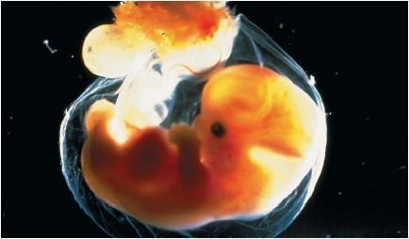
Results – Gene expression and functional pathways
20 DMRs previously associated with lung development or respiratory morbidity
8 of the top 10 identified DMRs located in known regulatory regions
Pathways related to regionalisation, DNA- and RNA-regulation and embryonic development

Slide 29

Discussion
White blood cells as surrogate for lung tissue
Genomic variants in Illumina probes
Estimated cell counts

Slide 30
Conclusions
59 DMRs associated with childhood lung function
Multiple identified DMRs associated with childhood asthma, and lung function and COPD in later life
DMRs related with differential gene expression and linked to genes involved in embryonic and respiratory tract development
These findings suggest epigenetic programming during fetal life of respiratory diseases across the life course

Slide 31

Acknowledgements
Janine Felix All collaborators from:
Johan de Jongste INMA
Joyce van Meurs CHS
Vincent Jaddoe Project Viva
Liesbeth Duijts The Rotterdam Study
Kimberley Burrows
George Davey-Smith
John Henderson
Caroline Relton

Slide 32
Thank you for your attention

Slide 33
EWAS - DMRs
A differentially methylated region (DMR) is a genomic region with multiple adjacent CpG sites that exhibit different methylation statuses among multiple samples
Identification of DMRs as opposed to single CpGs is conceptually consistent with what is known about DNA methylation patterns in the human genome
DMRs increase power to detect associations and allows for analysis of all probes on the array
Notes:
ADDITIONALE INFO DMRs

Slide 34
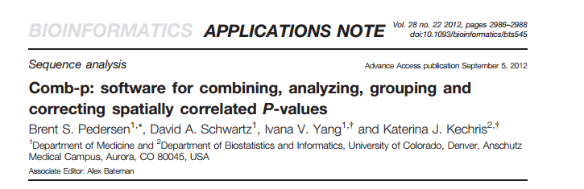
Comb-p

Slide 35
Comb-p: Rationale
P-values can be converted to z-scores and then summed and scaled to create a combined Z-score (Stouffer-Liptak: 1950)
P-values can be weigthed to perform a dependence correction on correlated tests (Zaykin: 2002)
Use a sliding window correction where each P-value is adjusted by applying the Stouffer–Liptak method to neighboring P-values as weighted according to the observed auto-correlation at the appropriate lag (Kechris: 2010)

Slide 36
Comb-p
Default steps:
1) calculate the autocorrelation (ACF) at varying distance lags
2) use the ACF to do the Stouffer-Liptak correction
3) do the Benjamini-Hochberg FDR correction
4) find regions from the adjusted p-values
5) create p-values for the identified regions

Slide 37
Other DMR-tools
BumpHunter
  internally filters out regions where the CpG site density is too sparse
  performance is greatly affected by false negatives
Probe Lasso
  more sensitive to sequenced DMRs
  performance is hindered by false positives
DMRcate
  Useful in large DMR lengths and large effects sizes
Peters, Epigenetics and Chromatin 2015
Notes:
Each method takes a slightly different approach to multiple testing. DMRcate performs a BH correction on the P values corresponding to all points at which the χ ² statistic is calculated, and takes the minimum adjusted P value in the region as representative, since all CpG sites within the specified window contribute to the support at that point. Very similarly, the Pvalues from Bumphunter regions are the minimum probe FDRs at which the associated area may be called significant, but Storey’s optimal discovery procedure [51] is used as a correction routine instead. comb-p uses a one-step Šidák correction [52] on the estimated region-wise Stouffer–Liptak P value. Very similarly to comb-p, Probe Lasso assigns P values to each of the ‘lassoed’ regions via Stouffer’s method [53], and then performs a region-wise BH correction. Hence, to avoid confounding due to unstandardised multiple testing procedures, we used quantile thresholding, commensurate with genomic coverage of DMRs called, for each validation point on the tuning domain. This was done by titrating values of the tuning parameter α (Table 1) appropriately to ensure complete coverage along the recall domain for each validation curve drawn. We generated 200 GRanges [54] objects from the resultant lists of DMRs for the 200 values of α, each corresponding to a point on the precision–recall curve.

Slide 38
Other DMR-tools
“Use comb-p for DMR finding in cases where the effect size are small – such as, for example, where no differential probes with P<0.05 are observed after BH correction”
Peters, Epigenetics and Chromatin 2015

Slide 39
