Slide 1
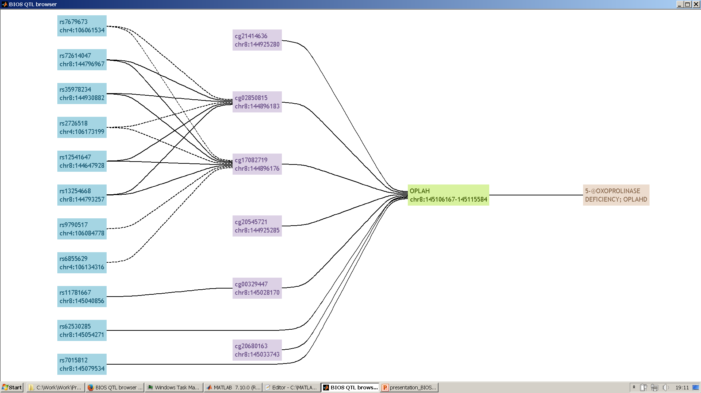

Online BIOS QTL atlases
Jan Bert van Klinken

Slide 2
Introduction
In BBMRI-NL a unique collection of omics datasets have been generated, reflecting different layers of biological processes
metabolome (NMR)
transcriptome (RNA-seq)
epigenome (CpG methylation)
genome (whole-genome seq)

Slide 3
Introduction
The BIOS consortium aims at integrating these layers of data, in order to uncover molecular pathways involved in health and disease.
Genome-wide association analyses between omics layers:
genome -> methylome (meQTLs)
genome -> transcriptome (eQTLs: gene, exon,
exon ratio, polyA ratio)
genome -> metabolome (metabolite QTLs)
methylome -> transcriptome (eQTMs)
methylome -> metabolome
transcriptome -> metabolome

Slide 4
BIOS QTL browser
An important task of BIOS is to make the association results available
to the public. To this end, a QTL web browser has been developed by
the BIOS team: http://genenetwork.nl/biosqtlbrowser
Data can be downloaded all at once
or the database can be queried
for specific SNPs, CpG sites, genes.
Currently, query results are presented
in tabular format separately for each
association study.

Slide 5
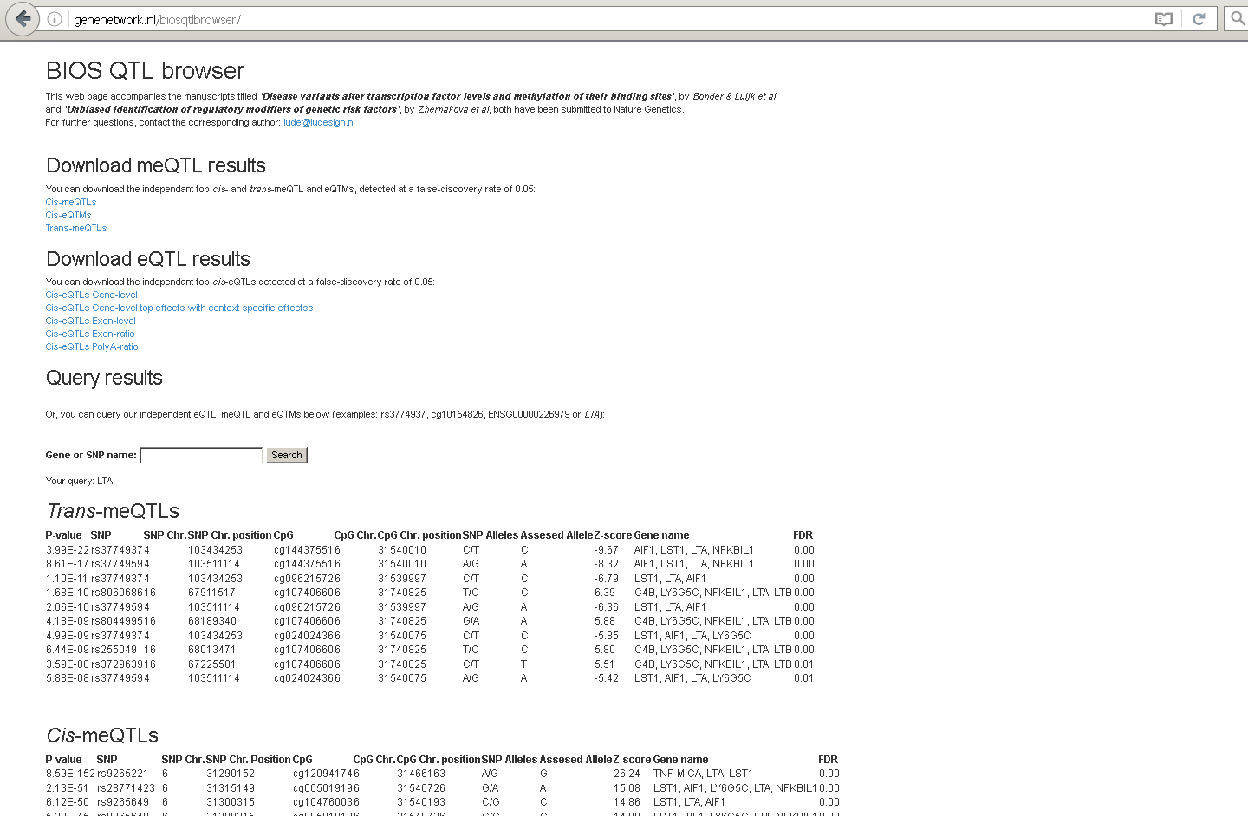
BIOS QTL browser

Slide 6
BIOS QTL browser
bulk download
query database
query results

Slide 7
BIOS QTL browser
The current BIOS QTL browser will be improved
Goal
Make BIOS QTL results accessible for and interpretable by a wide range
of users* through a user-friendly** and sustainable*** web application.
* users with different expertises and backgrounds
** present results in a visually more appealing way
*** easy to maintain and to add new association results or data layers

Slide 8
Prototype development
Make QTL browser more user-friendly and flexible:
better represent omics data layers and associations between layers
variants
CpG sites
genes
phenotypes

Slide 9
Prototype development
Alpha version of new QTL browser (query: OPLAH)

Slide 10
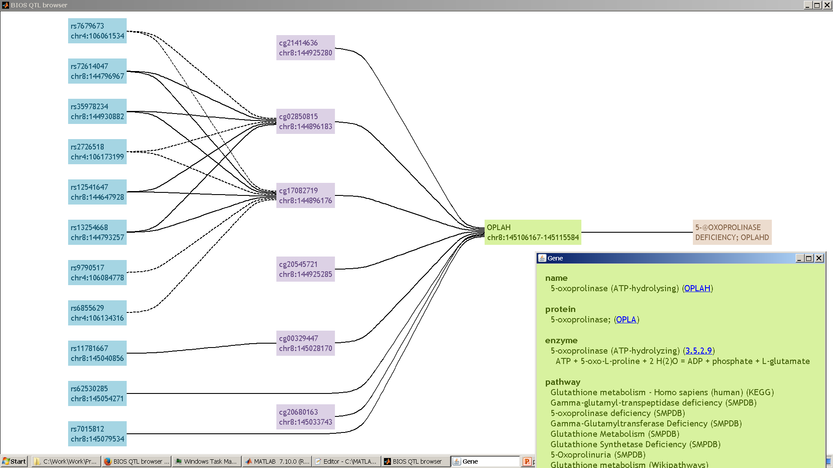
Prototype development
Alpha version of new QTL browser (query: OPLAH)

Slide 11
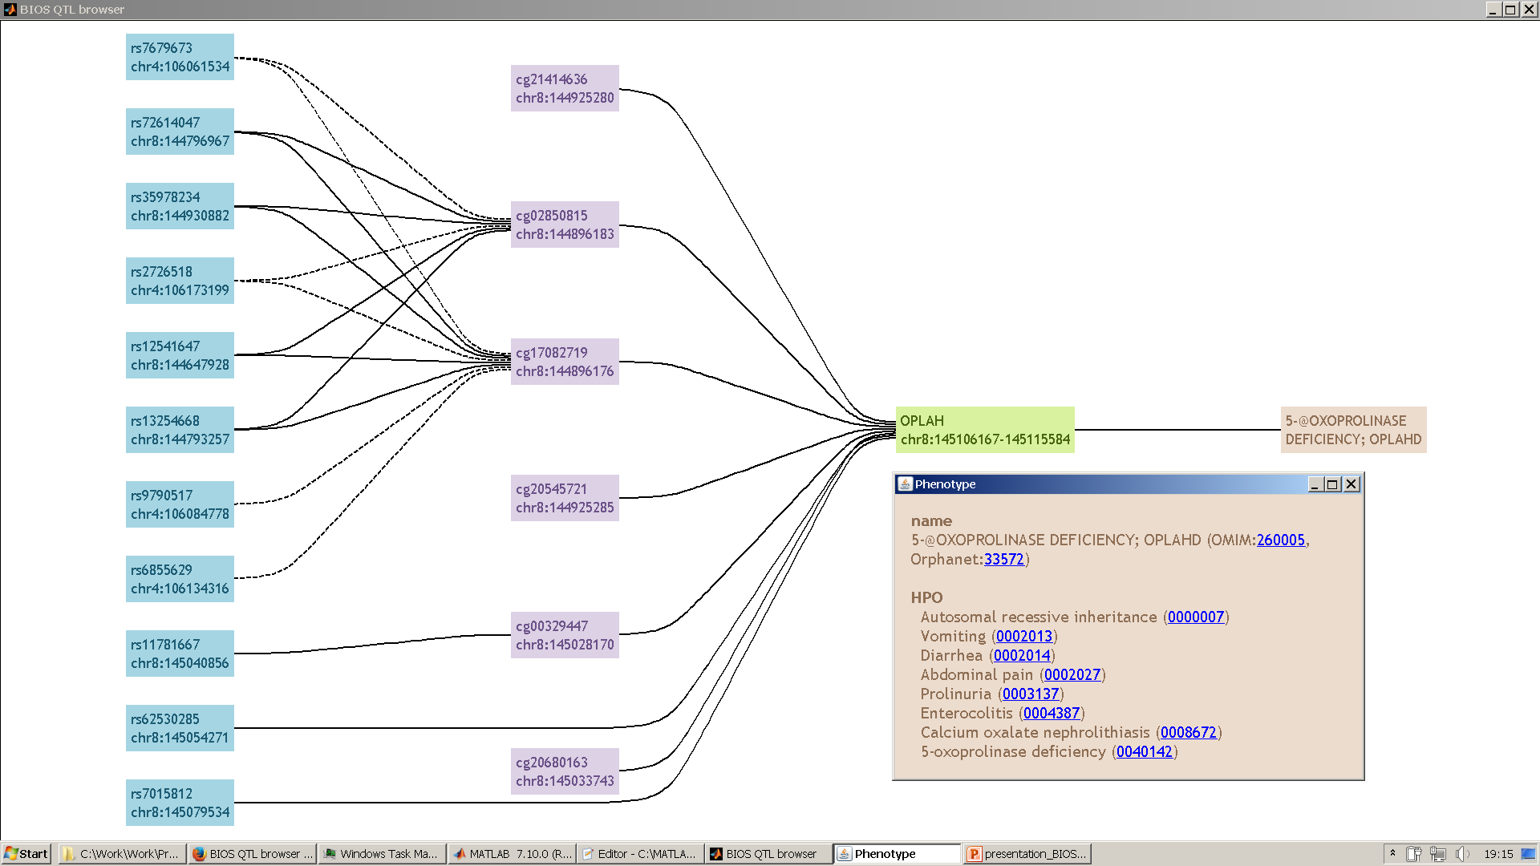
Prototype development
Alpha version of new QTL browser (query: OPLAH)

Slide 12
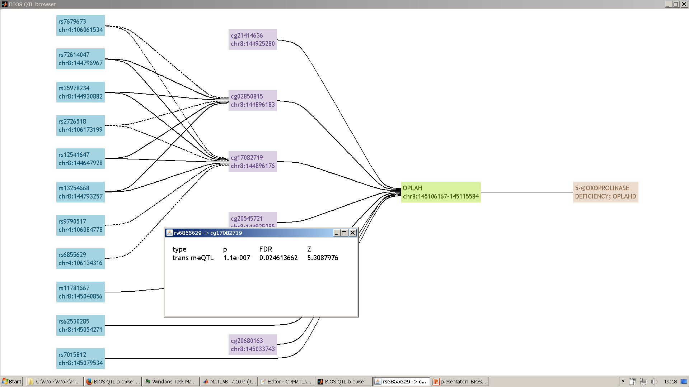
Prototype development
Alpha version of new QTL browser (query: OPLAH)

Slide 13
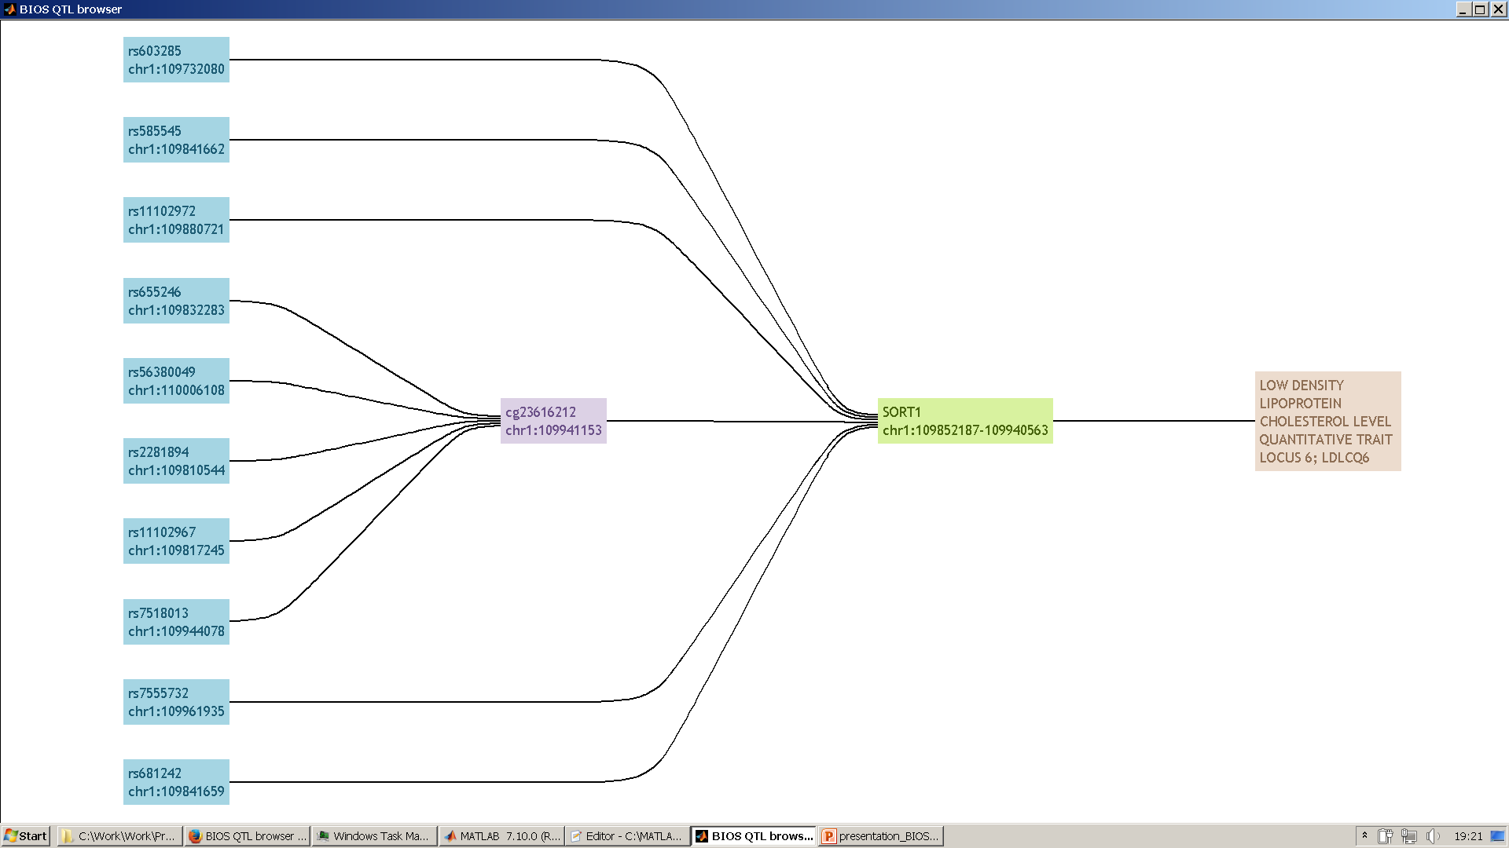
Prototype development
Alpha version of new QTL browser (query: SORT1)

Slide 14
Prototype development
SNP query -> list of SNPs in LD -> find meQTLs -> list CpG sites
-> find eQTLs -> list of genes
-> find QTLs -> list of phenotypes
-> CpG chr pos overlap -> list of CpG sites
-> 5' UTR/exon chr pos overlap -> list of genes
list of CpG sites -> find eQTMs -> list of genes
-> find associated phenotypes -> list of phenotypes
list of genes -> find related diseases -> list of phenotypes
For each SNP, CpG site, gene and phenotype, gather functional information from external databases and hyperlinks to database entries.
Show resulting SNPs, CpG sites, genes, phenotypes and intermediate associations in a layered graph.

Slide 15
Prototype development
Exploit database integration pipeline developed for QTL annotation

Slide 16
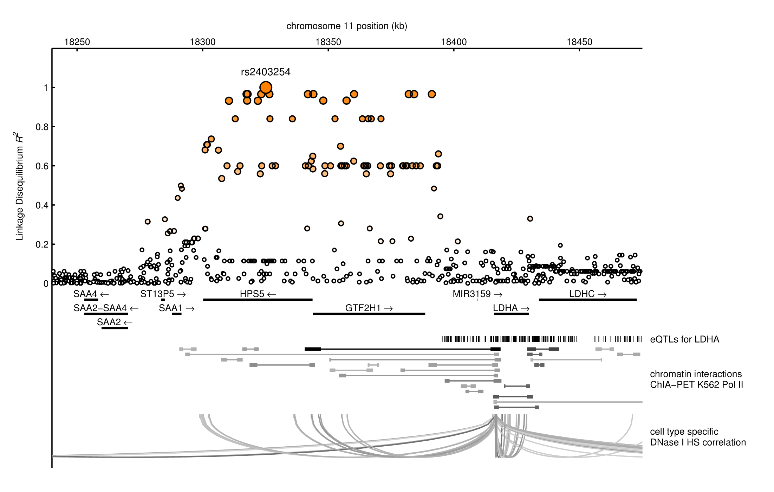
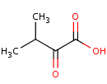
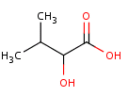
Case study
Reanalysis of metabolite GWAS results of Suhre et al (Nature, 2011)
Creating SNP reports for all QTLs, we found that LDHA is the most logical candidate gene that could explain the the effect on the metabolite levels (Heemskerk et al, EJHG, 2015)
HPS5 ???
3-methyl-2-oxobutyrate
α-hydroxyisovalerate

Slide 17
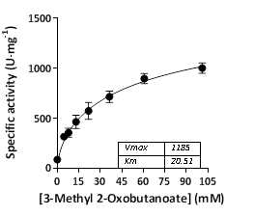
Case study
We showed that LDH can catalyze this conversion in vitro, suggesting that lactate dehydrogenase plays a role in branched-chain amino acid metabolism.
Integration with ENCODE
data showed chromatin
interaction between
rs2403254 and the LDHA TSS.
3-methyl-2-oxobutyrate
α-hydroxyisovalerate
Heemskerk et al., 2015

Slide 18
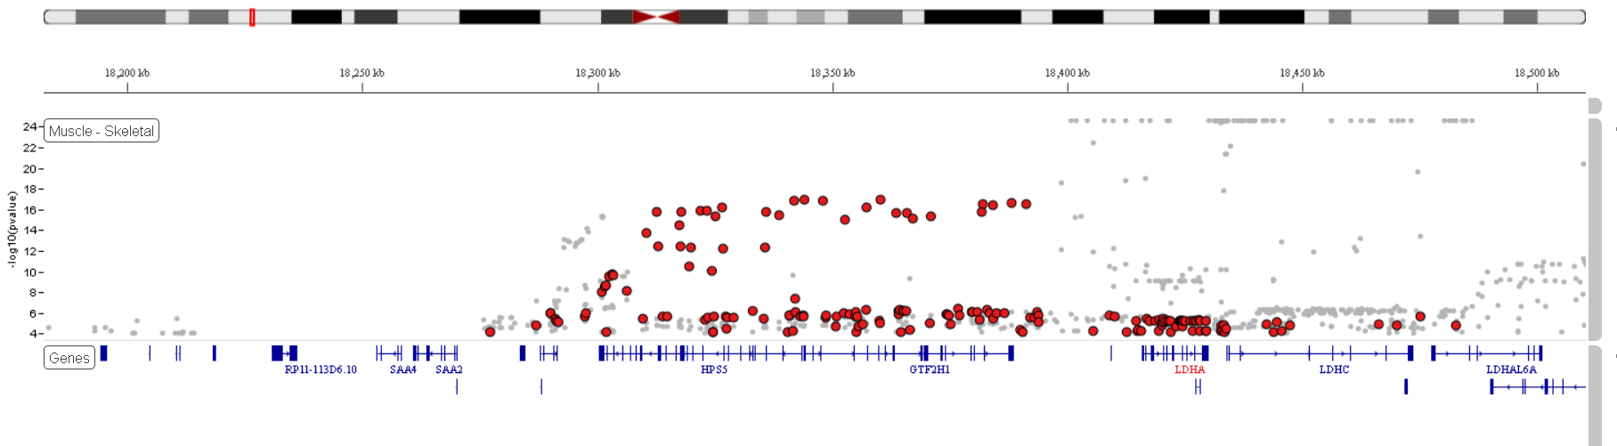
Case study
We showed that LDH can catalyze this conversion in vitro, suggesting that lactate dehydrogenase plays a role in branched-chain amino acid metabolism.
Recent data from GTEx V6p confirmed that rs2403254 is an eQTL for LDHA in the muscle.
3-methyl-2-oxobutyrate
α-hydroxyisovalerate
Heemskerk et al., 2015

Slide 19
Current and future work
Finish prototype (implement LD computation, enable different types of queries)
Front end: develop dynamic web application to display query results as a layered network.
Back end: convert existing MATLAB scripts into server-side scripts (JavaScript+Node.js, Perl, Python) and store database content in a format that can be efficiently queried (CSV, JSON, RDF, MySQL, levelDB).

Slide 20
Conclusion
Task of BIOS to develop a user-friendly and sustainable
web application to browse QTL results.
First version online: http://genenetwork.nl/biosqtlbrowser .
Prototype of new browser has been developed that emphasizes layered structure in the data.
Which additional features will/should be added is open for discussion.

Slide 21
BIOS QTL browser
Features
Report variants in strong Linkage Disequilibrium with top SNPs
Functional annotation of genetic variants and methylation sites (histone marks, DNAse activity, TF binding)
Gather gene-specific knowledge from external databases
(gene function, role in pathways, implication in disease)
Complex / composite queries (e.g. variant list and gene combinations)
Download query results
Develop API to facilitate data access
FAIR-ification of QTL results (Findable Accessible Interoperable Reusable)
Open for discussion - all input is welcome!
j.b.van_klinken@lumc.nl

